Slide 1
The Basics of Measurement

Slide 2
Measurement
Ordinarily, when we measure things, we do not think about the scientific principles we are applying.
We measure attributes such as the length of physical objects, the timing of events, and the temperature of liquids or of the air.
To do the measuring, we use both tools and principles that we now take for granted.
For example, using the length of a column of mercury to capture information about temperature
Unknown to the first person who wanted to know how much hotter it is in summer than in winter.
we developed a framework for describing temperature as well as tools for measuring it.

Slide 3
Measurement
Questions that are relatively easy to answer for non-software entities are difficult for software. For example,
How much must we know about an attribute before it is reasonable to consider measuring it? For instance, do we know enough about complexity” of programs to be able to measure it?
How do we know if we have really measured the attribute we wanted to measure? For instance, does a count of the number of “bugs” found in a system during integration testing measure the quality of the system? If not, what does the count tell us?
Using measurement, what meaningful statements can we make about an attribute and the entities that possess it? For instance, is it meaningful to talk about doubling a design’s quality? If not, how do we compare two diﬀerent designs?
To answer these questions, we must establish the basics of a theory of measurement.

Slide 4
Metrology
Metrology is the scientific study of measurement.
Metrology is the basis for empirical science and engineering in order to bring knowledge under general laws, i.e., to distil observations into formal theories and express them mathematically.
Measurement is used for formal (logical or mathematical, orderly and reliable) representation of observation.
Notes:
In European soccer leagues, a points system is used to select the best all-around team over the course of a season. Until the early 1980s, two points were awarded for each win and one point was awarded for each draw. Thereafter, the points system was changed; a win yielded three points instead of two, while a draw still yielded one point. This change was made to reﬂect the consensus view that the qualitative difference between a win and a draw was greater than that between a draw and a defeat

Slide 5
Components of a measurement system
Components of a measurement system:
m = <attribute, scale, unit>
Attribute is what is being measured (e.g., size of a program)
Scale is the standard and scope of measurement (e.g., nominal, ordinal, ratio scale, etc.)
Unit is the physical meaning of scale (e.g., a positive integer, a symbol, etc.)
Determining the value of an attribute of an entity.
Notes:
In European soccer leagues, a points system is used to select the best all-around team over the course of a season. Until the early 1980s, two points were awarded for each win and one point was awarded for each draw. Thereafter, the points system was changed; a win yielded three points instead of two, while a draw still yielded one point. This change was made to reﬂect the consensus view that the qualitative difference between a win and a draw was greater than that between a draw and a defeat

Slide 6
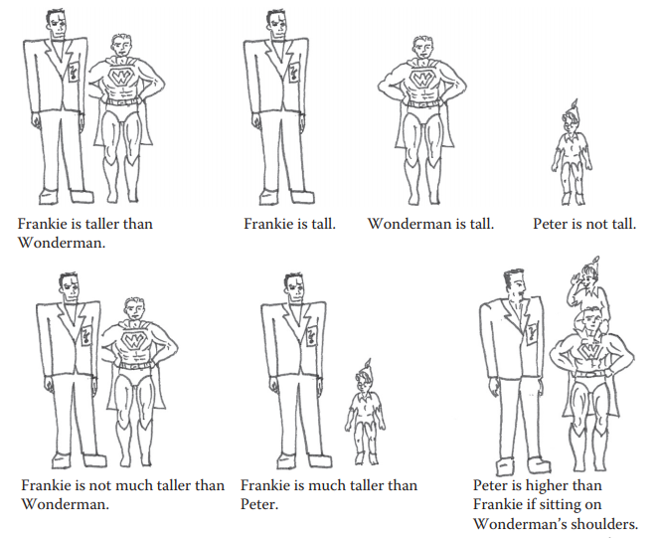
Empirical Relations
The representational theory of measurement seeks to formalize our intuition about the way the world works.
Given any two people, x and y, we can observe that • x is taller than y, or • y is taller than x
Therefore, we say that taller than is an empirical relation for height.
Notes:
In European soccer leagues, a points system is used to select the best all-around team over the course of a season. Until the early 1980s, two points were awarded for each win and one point was awarded for each draw. Thereafter, the points system was changed; a win yielded three points instead of two, while a draw still yielded one point. This change was made to reﬂect the consensus view that the qualitative difference between a win and a draw was greater than that between a draw and a defeat

Slide 7
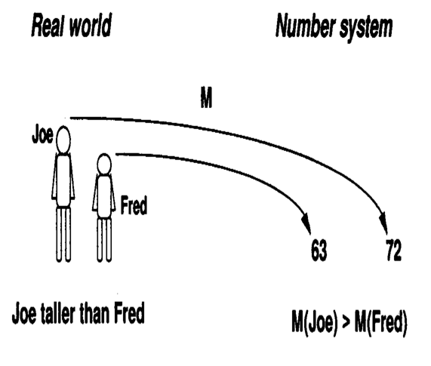
Empirical Relations
Empirical relation preserved under measurement M as numerical relation
Notes:
In European soccer leagues, a points system is used to select the best all-around team over the course of a season. Until the early 1980s, two points were awarded for each win and one point was awarded for each draw. Thereafter, the points system was changed; a win yielded three points instead of two, while a draw still yielded one point. This change was made to reﬂect the consensus view that the qualitative difference between a win and a draw was greater than that between a draw and a defeat

Slide 8












Real, Empirical & Formal Worlds
Measurement
Real World
Empirical World
Scales & Units
Formal World
Modeling & Verification
Mapping
Mathematical (logical) Model
Notes:
In European soccer leagues, a points system is used to select the best all-around team over the course of a season. Until the early 1980s, two points were awarded for each win and one point was awarded for each draw. Thereafter, the points system was changed; a win yielded three points instead of two, while a draw still yielded one point. This change was made to reﬂect the consensus view that the qualitative difference between a win and a draw was greater than that between a draw and a defeat

Slide 9


Real, Empirical & Formal Worlds
Measurement
Height
Entity A
197
Entity B
124
Scale: ratio unit: cm
M(A) > M(B)
Modeling & Verification
Mapping
Notes:
In European soccer leagues, a points system is used to select the best all-around team over the course of a season. Until the early 1980s, two points were awarded for each win and one point was awarded for each draw. Thereafter, the points system was changed; a win yielded three points instead of two, while a draw still yielded one point. This change was made to reﬂect the consensus view that the qualitative difference between a win and a draw was greater than that between a draw and a defeat

Slide 10
Measurement: Activities
Problem definition
Defining measurement problem
Designating set of entities forming the target of measurement
Identifying key attributes for the entities
Identifying scales
Identifying scales for which the attributes can be measured
Forming the empirical relational system
Mapping entities and their selected attributes to numbers or values on the scales
Notes:
In European soccer leagues, a points system is used to select the best all-around team over the course of a season. Until the early 1980s, two points were awarded for each win and one point was awarded for each draw. Thereafter, the points system was changed; a win yielded three points instead of two, while a draw still yielded one point. This change was made to reﬂect the consensus view that the qualitative difference between a win and a draw was greater than that between a draw and a defeat

Slide 11
Measurement: Activities
Modeling
Developing mathematical (logical) representation of the entities and their attributes
Defining the formal relational system
Mapping the empirical relational system to the formal model
Verifying the results of measurement
Verifying whether the measurement results reflect the properties of the entities, attributes and relationships
Notes:
In European soccer leagues, a points system is used to select the best all-around team over the course of a season. Until the early 1980s, two points were awarded for each win and one point was awarded for each draw. Thereafter, the points system was changed; a win yielded three points instead of two, while a draw still yielded one point. This change was made to reﬂect the consensus view that the qualitative difference between a win and a draw was greater than that between a draw and a defeat

Slide 12
Example 1
Ranking 4 software (contact management) products based on user preferences
Problem definition: ranking the products (entities) A, B, C and D based on user preferences
Scale: A single 0-100% linear scale
Empirical relational system: represented by the table
 | A | B | C | D
A | - | 80 | 10 | 80
B | 20 | - | 5 | 50
C | 90 | 95 | - | 96
D | 20 | 50 | 4 | -
(A,B) = 80 means 80% rated program A as having greater functionality than B
Notes:
In European soccer leagues, a points system is used to select the best all-around team over the course of a season. Until the early 1980s, two points were awarded for each win and one point was awarded for each draw. Thereafter, the points system was changed; a win yielded three points instead of two, while a draw still yielded one point. This change was made to reﬂect the consensus view that the qualitative difference between a win and a draw was greater than that between a draw and a defeat

Slide 13
Example 1
Modeling:
Valid pairs are those having the value greater that 60.
If for a pair (A,B) , more than 60% of users prefer A to B then A is “definitely better” than B.
If M(x,y) > 60% then p(x) > p(y)
Formal relation system:
If p(x) > p(y) and p(y) > p(z)
then, p(x) > p(z)
Verification:
Valid pairs (C,A), (C,B), (C,D), (A,B) and (A,D)
No conflict between the data collected and the model
 | A | B | C | D
A | - | 80 | 10 | 80
B | 20 | - | 5 | 50
C | 90 | 95 | - | 96
D | 20 | 50 | 4 | -
(A,B) = 80 means 80% rated program A as having greater functionality than B
Notes:
In European soccer leagues, a points system is used to select the best all-around team over the course of a season. Until the early 1980s, two points were awarded for each win and one point was awarded for each draw. Thereafter, the points system was changed; a win yielded three points instead of two, while a draw still yielded one point. This change was made to reﬂect the consensus view that the qualitative difference between a win and a draw was greater than that between a draw and a defeat

Slide 14
Example 1
Verification fails if the data was collected as shown here because
M(B,C) > 60% then p(B) > p(C)
M(C,A) > 60% then p(C) > p(A)
M(A,B) > 60% then p(A) > p(B)
There is a conflict between the real and formal model and the model must be revised.
 | A | B | C | D
A | - | 80 | 10 | 80
B | 20 | - | 95 | 50
C | 90 | 5 | - | 96
D | 20 | 50 | 4 | -
Notes:
In European soccer leagues, a points system is used to select the best all-around team over the course of a season. Until the early 1980s, two points were awarded for each win and one point was awarded for each draw. Thereafter, the points system was changed; a win yielded three points instead of two, while a draw still yielded one point. This change was made to reﬂect the consensus view that the qualitative difference between a win and a draw was greater than that between a draw and a defeat

Slide 15
Example 2
Entity: software failure
Attribute: criticality
Three types of failure is observed:
Delayed response
Incorrect output
Data loss
There are 3 failure classes in E
Delayed response (R1)
Incorrect output (R2)
Data loss (R3)
Notes:
In European soccer leagues, a points system is used to select the best all-around team over the course of a season. Until the early 1980s, two points were awarded for each win and one point was awarded for each draw. Thereafter, the points system was changed; a win yielded three points instead of two, while a draw still yielded one point. This change was made to reﬂect the consensus view that the qualitative difference between a win and a draw was greater than that between a draw and a defeat

Slide 16
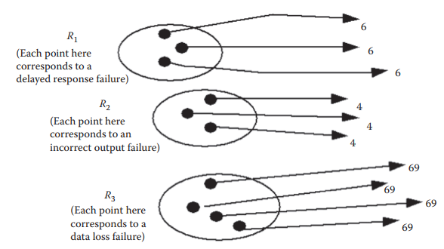
Example 2
Measurement mapping
Notes:
In European soccer leagues, a points system is used to select the best all-around team over the course of a season. Until the early 1980s, two points were awarded for each win and one point was awarded for each draw. Thereafter, the points system was changed; a win yielded three points instead of two, while a draw still yielded one point. This change was made to reﬂect the consensus view that the qualitative difference between a win and a draw was greater than that between a draw and a defeat

Slide 17
Example 2
Next we would like to add a new binary relation:
x is more critical than y
Each data loss failure (x in R3) is more critical than incorrect output failure (y in R2) and delayed response failure (y in R1)
Each incorrect output failure (x in R2) is more critical than delayed response failure (y in R1)
The model should be revised to account for this new binary relation
Notes:
In European soccer leagues, a points system is used to select the best all-around team over the course of a season. Until the early 1980s, two points were awarded for each win and one point was awarded for each draw. Thereafter, the points system was changed; a win yielded three points instead of two, while a draw still yielded one point. This change was made to reﬂect the consensus view that the qualitative difference between a win and a draw was greater than that between a draw and a defeat

Slide 18
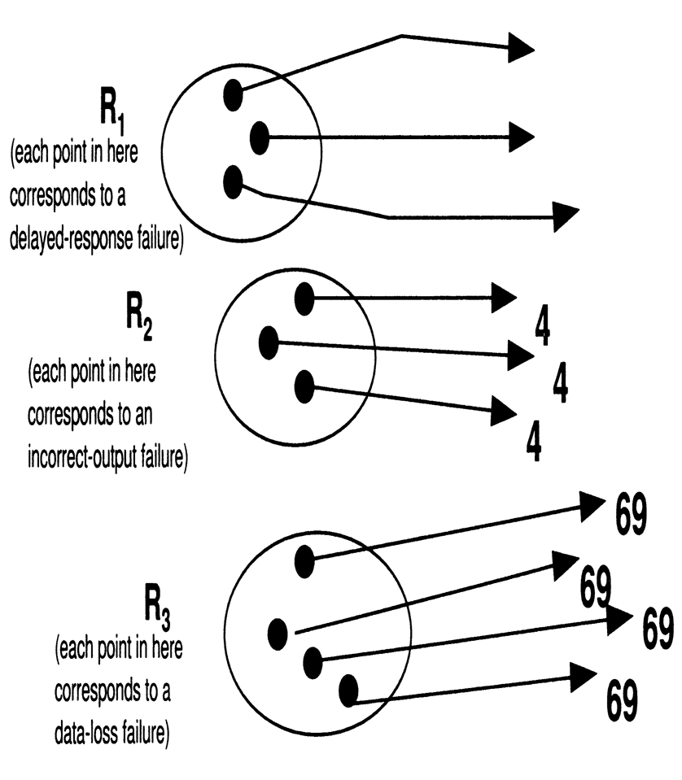
Example 2
Revised measurement mapping
3
3
3
Notes:
In European soccer leagues, a points system is used to select the best all-around team over the course of a season. Until the early 1980s, two points were awarded for each win and one point was awarded for each draw. Thereafter, the points system was changed; a win yielded three points instead of two, while a draw still yielded one point. This change was made to reﬂect the consensus view that the qualitative difference between a win and a draw was greater than that between a draw and a defeat

Slide 19
Direct and Derived Measurement
Direct measurement of an attribute of an entity involves no other attribute or entity.
E.g., length of a physical object
Example for software:
Size of source code (measured by LOC)
Schedule of the testing process (measured by elapsed time in hours)
Number of defects discovered (measured by counting defects)
Time a programmer spends on a project (measured by months worked)
Notes:
In European soccer leagues, a points system is used to select the best all-around team over the course of a season. Until the early 1980s, two points were awarded for each win and one point was awarded for each draw. Thereafter, the points system was changed; a win yielded three points instead of two, while a draw still yielded one point. This change was made to reﬂect the consensus view that the qualitative difference between a win and a draw was greater than that between a draw and a defeat

Slide 20
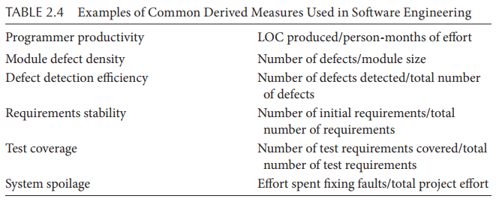
Direct and Derived Measurement
Indirect measurement is useful in making visible the interaction between direct measurements.
E.g., density of a physical object. Density = Mass/Volume
Example for software:
Notes:
In European soccer leagues, a points system is used to select the best all-around team over the course of a season. Until the early 1980s, two points were awarded for each win and one point was awarded for each draw. Thereafter, the points system was changed; a win yielded three points instead of two, while a draw still yielded one point. This change was made to reﬂect the consensus view that the qualitative difference between a win and a draw was greater than that between a draw and a defeat

Slide 21
Direct and Derived Measurement
Direct measurement forms the building blocks for our assessment, but many interesting attributes can be measured only by derived measurement.
Indirect measurement is particularly helpful when the size of empirical measures is quite big (i.e., many relations and many entities) or the cost of direct measurement is high.
Notes:
In European soccer leagues, a points system is used to select the best all-around team over the course of a season. Until the early 1980s, two points were awarded for each win and one point was awarded for each draw. Thereafter, the points system was changed; a win yielded three points instead of two, while a draw still yielded one point. This change was made to reﬂect the consensus view that the qualitative difference between a win and a draw was greater than that between a draw and a defeat

Slide 22
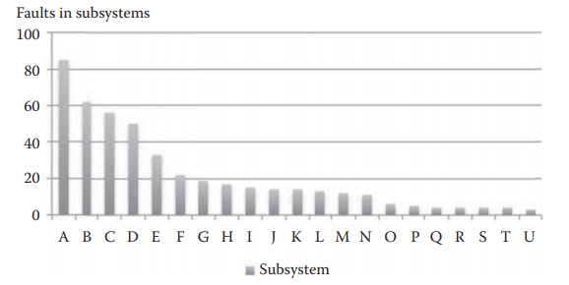
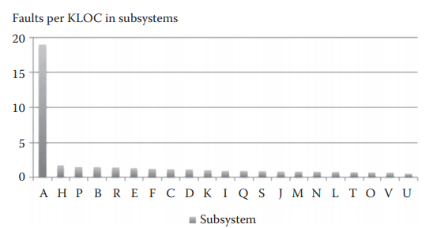
Direct and Derived Measurement
In a software system, measuring number of faults (i.e., direct measurement) leads to identification of 5 problem areas.
However, measuring faults per KLOC (i.e., indirect measurement) leads to identification of only one problem area.
Notes:
In European soccer leagues, a points system is used to select the best all-around team over the course of a season. Until the early 1980s, two points were awarded for each win and one point was awarded for each draw. Thereafter, the points system was changed; a win yielded three points instead of two, while a draw still yielded one point. This change was made to reﬂect the consensus view that the qualitative difference between a win and a draw was greater than that between a draw and a defeat

Slide 23
Measurement: Size of Empirical Set
Example: measuring popularity of 4 software products
E = {A, R}
| A| = 4
| R| = 3
r1: x is more popular than y
r2: x is less popular than y
r3: indifferent
The total number of possible measures is: 4 × (4 - 1) × 3 = 36
The size will grow when the number of elements and relations grow.
Notes:
In European soccer leagues, a points system is used to select the best all-around team over the course of a season. Until the early 1980s, two points were awarded for each win and one point was awarded for each draw. Thereafter, the points system was changed; a win yielded three points instead of two, while a draw still yielded one point. This change was made to reﬂect the consensus view that the qualitative difference between a win and a draw was greater than that between a draw and a defeat

